Slide 1
HR Perspective:
What Kind of Employees Would Get Promoted?
BA880 - People Analytics
Team Juicy
Fusu, Allen, Caroline

Slide 2
Table of Contents
Introduction
EDA &
Our Guess
01
02
Topic
Dataset & Preprocessing
Basic information
Performance
Feature Engineering
Models & Conclusion
03
04
Random Forest
Prediction Models
Conclusion & Rec

Slide 3
Introduction
01
01
Topic
Dataset & Preprocessing

Slide 4

HR Analysis
on
Employee’s Promotion Record
Categorize the characteristics an employee need to be promoted
Predict whether an employee with certain features can be promoted

Slide 5
About the Dataset
Dataset: HR Perspective: Job Promotion (https://www.kaggle.com/shivan118/hranalysis)
54,808 rows and 14 columns
(48,660 entries after data cleaning)
12 features to analyze
Target feature: ‘is_promoted’

Slide 6
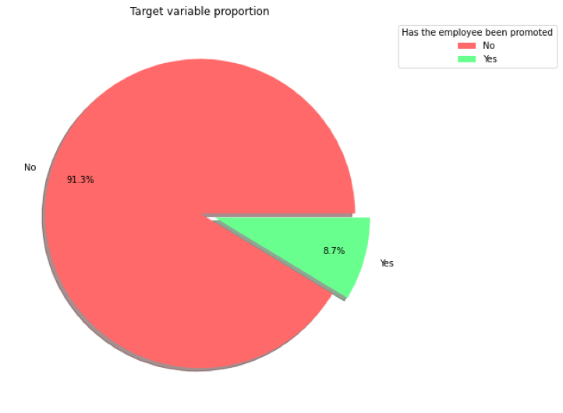
‘Is_promoted’ proportion
No
01
91.3% of the employees have not been promoted
Yes
02
8.7% of the employees have been promoted

Slide 7
03
EDA & Our Guesses
02
Basic information
Performance

Slide 8
2 main categories of the 12 features
2.1
Personal Information
2.2
Performance Evaluation
gender, age, department, region, education degree, recruitment
channel

Slide 9
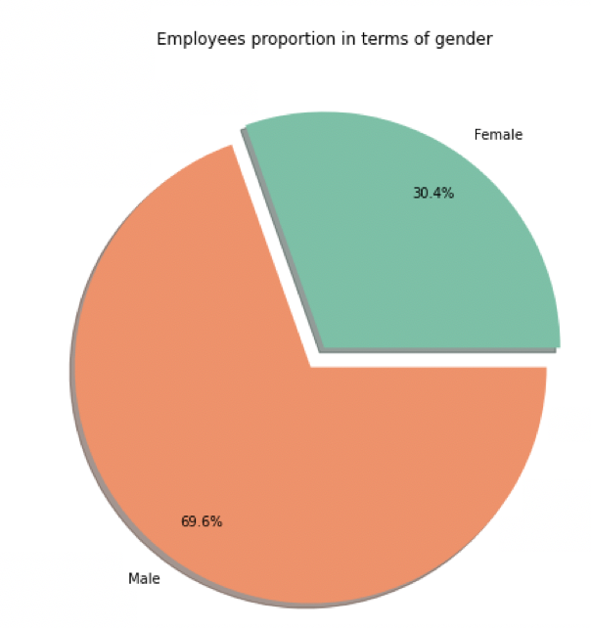
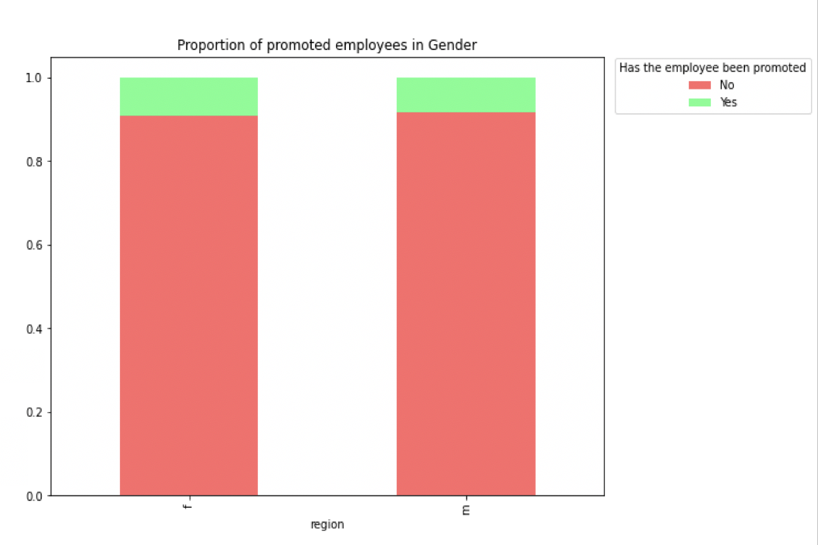
Gender
Gender shows little impact on the decision of promotion
Gender proportion
Proportion of promoted employees in gender

Slide 10
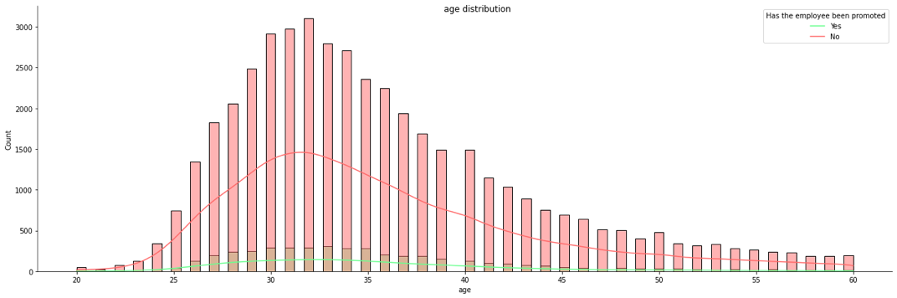
Age Distribution
slightly right skewed

Slide 11
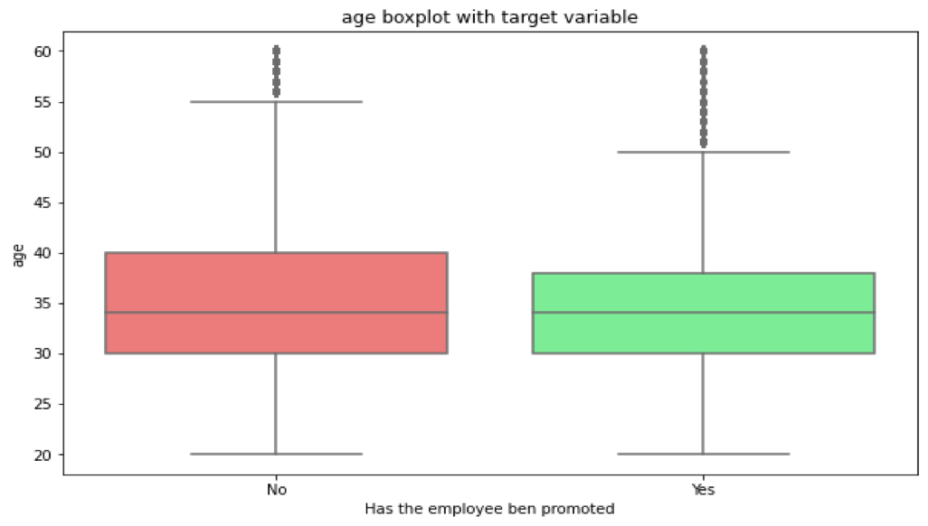
Age Against Target
No significant age impact in promoting decisions

Slide 12
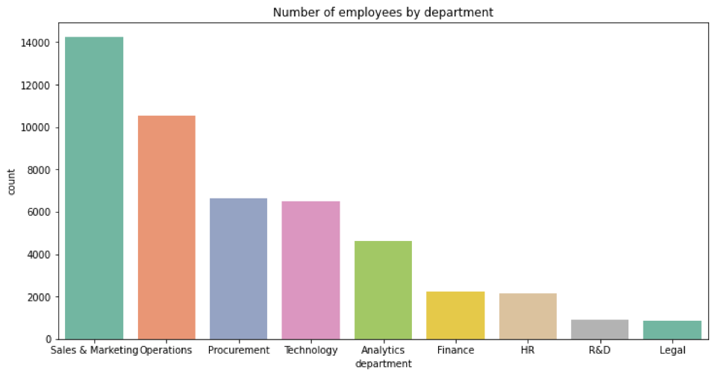
Department Distribution
"

Slide 13
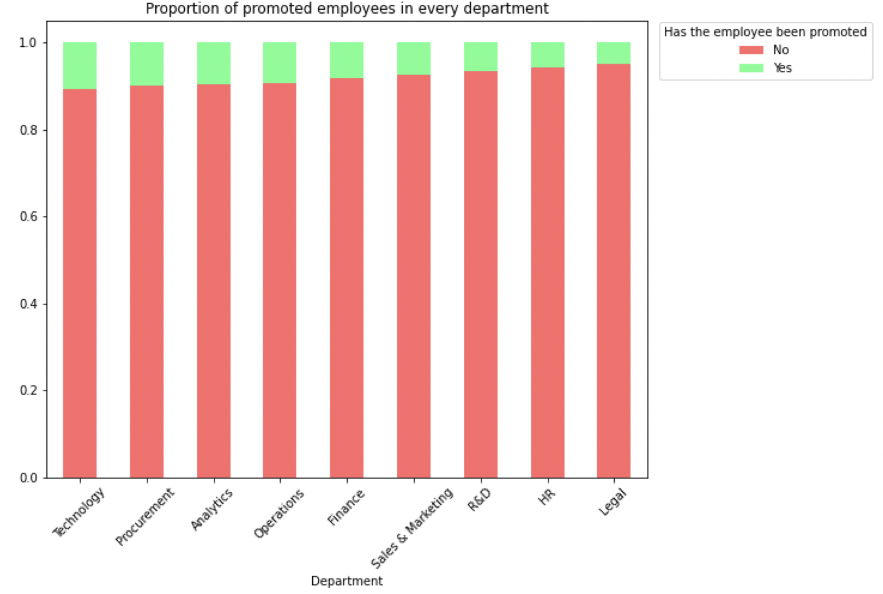
Department Against Target
"
exist a trend of promoting employees in technology, procurement and analytics

Slide 14
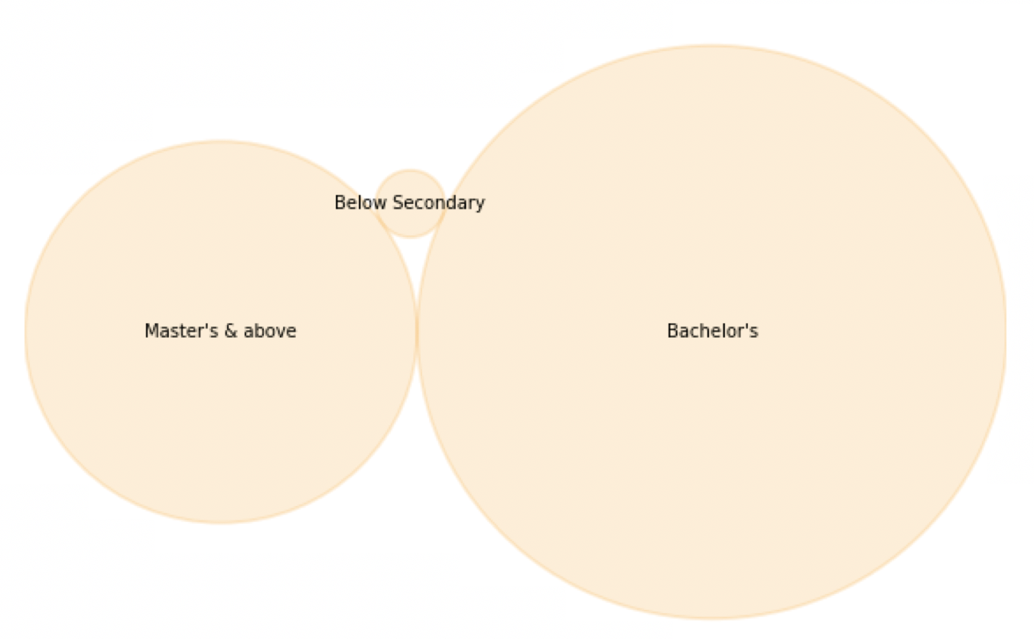
Education Background Distribution

Slide 15
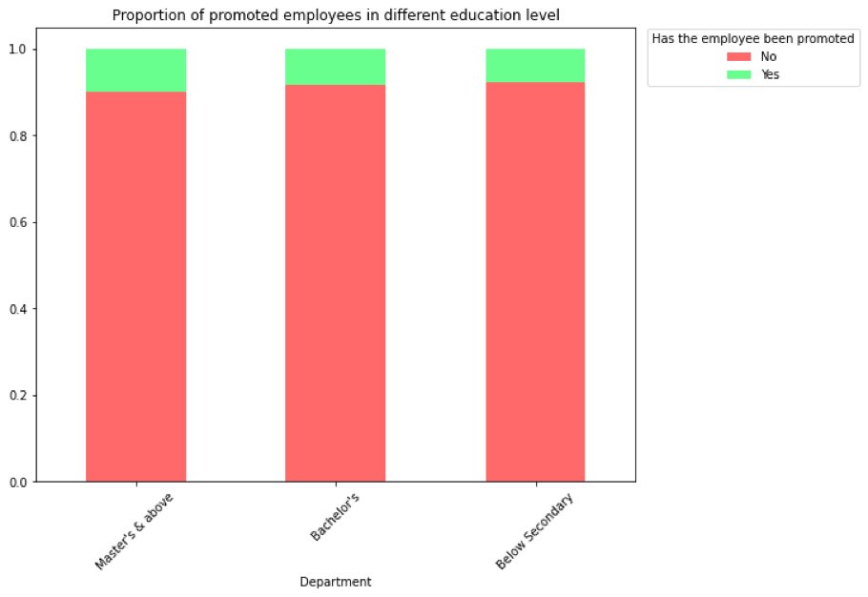
Education Background Against Target
slightly lean-to people with master’s or higher degree

Slide 16
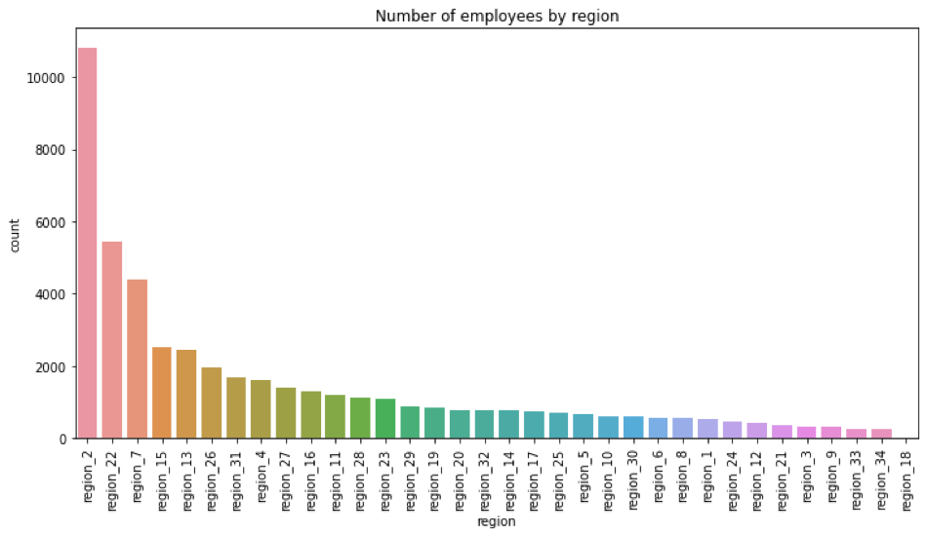
Region Distribution
"

Slide 17
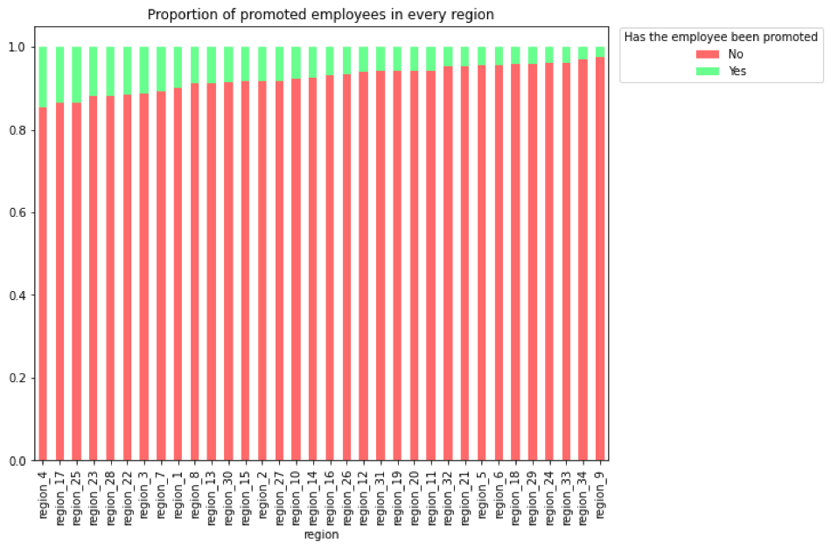
Region Against Target
"
The company does show preferences on specific regions

Slide 18
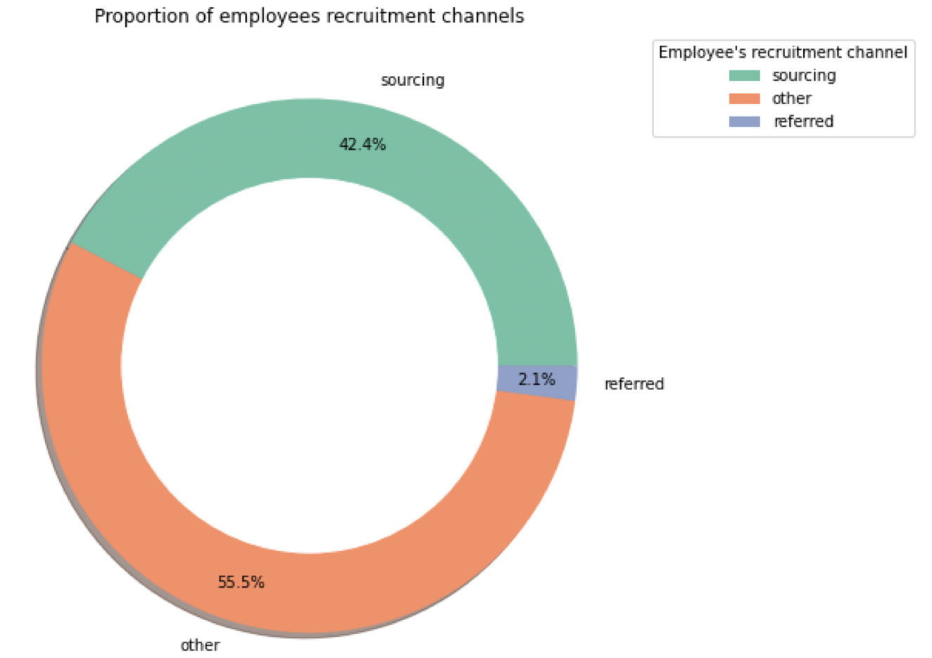
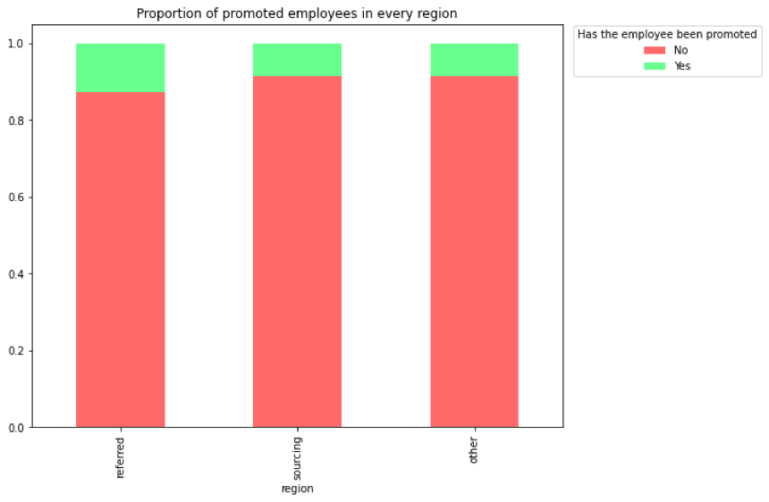
Recruitment Channel
Distinction between channel referrals and others
Recruitment Channel Distribution
Recruitment Channel Against Target

Slide 19
2 main categories of the 12 features
2.2
Performance Evaluation
2.1
Personal Information
# of trainings the employee has,
previous year rating,
length of service, if the employee meets 80% of the KPI, if the employee won any awards,
employee’s average training score

Slide 20
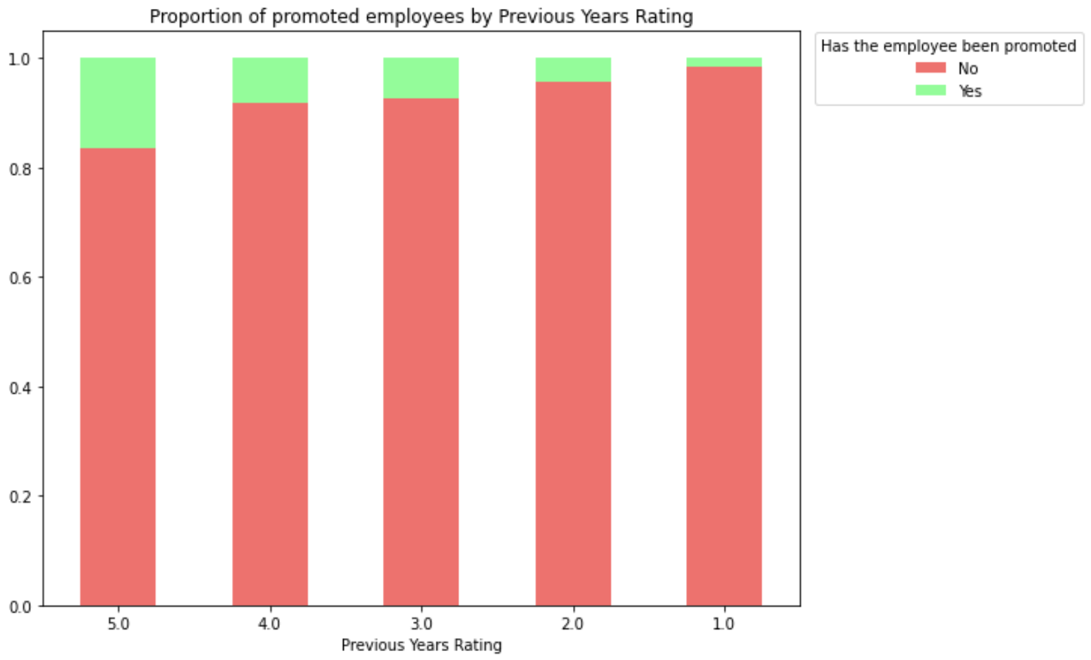
Previous Year Rating
Employees proportion with Previous Year
Rating
Higher rating -
Higher promotion

Slide 21
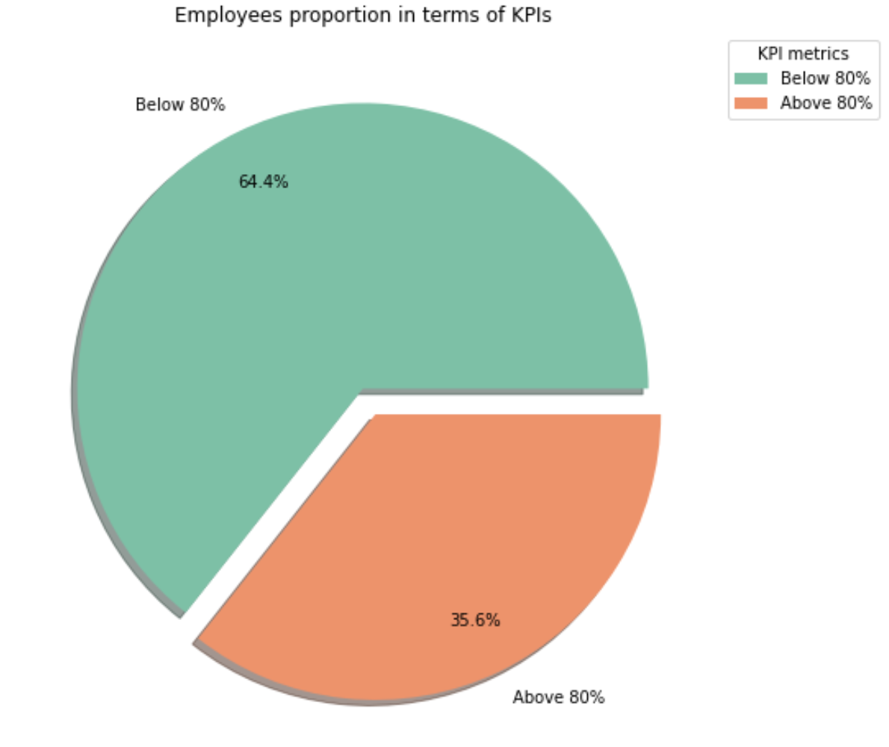
Effect of KPIs
64.4% employees KPI < 80%
35.6% KPI > 80%

Slide 22
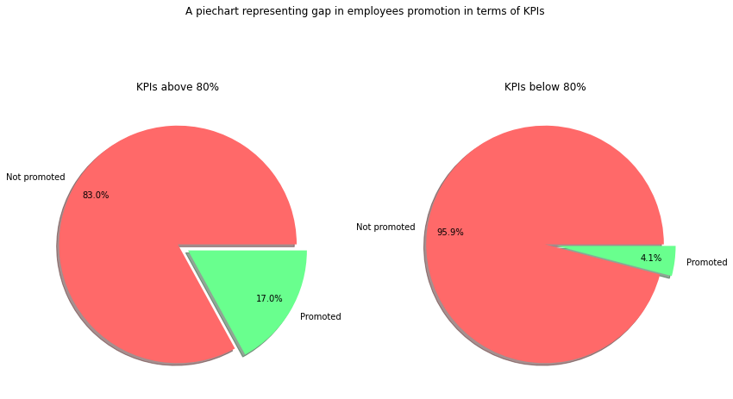
Effect of KPIs

Slide 23
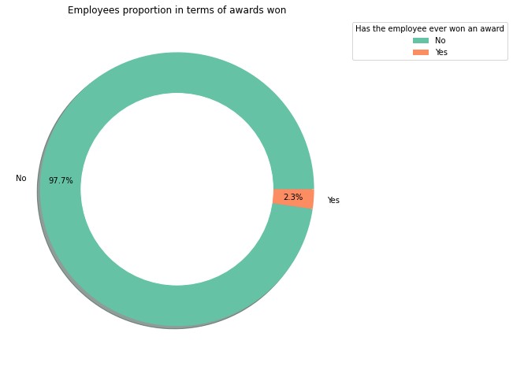
Awards Won
Employees proportion in terms of award won
Only 2.3% won awards

Slide 24
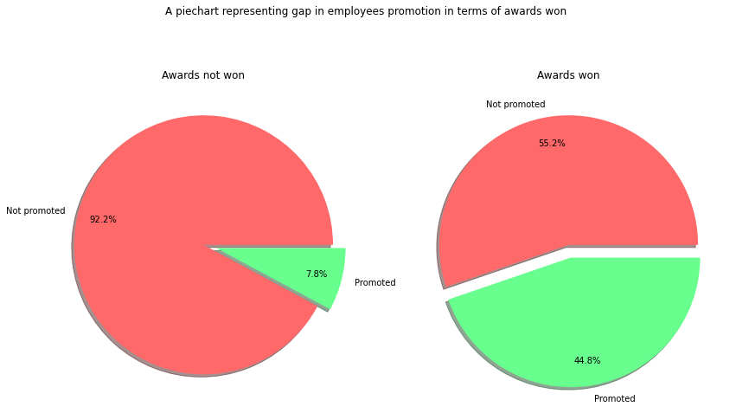
Awards Won

Slide 25
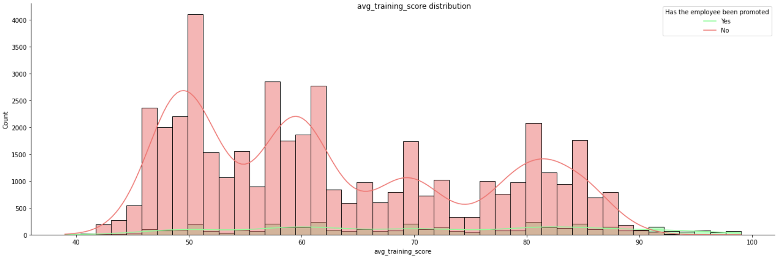
Training Score
Employee number has a slightly decreasing trend when scores getting higher

Slide 26
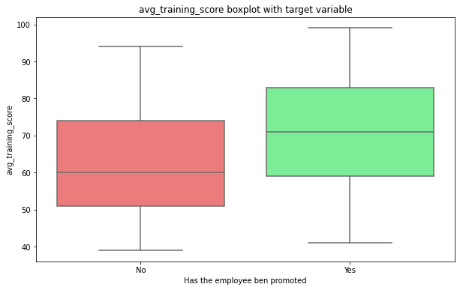
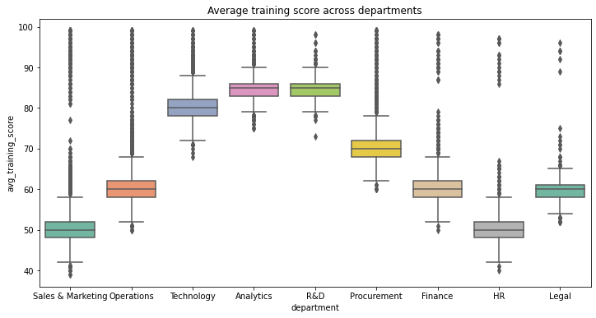
Training Score
Different medians of score
Score differs across departments

Slide 27
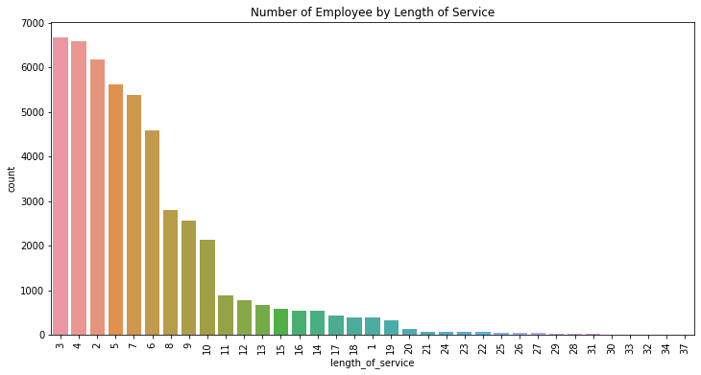
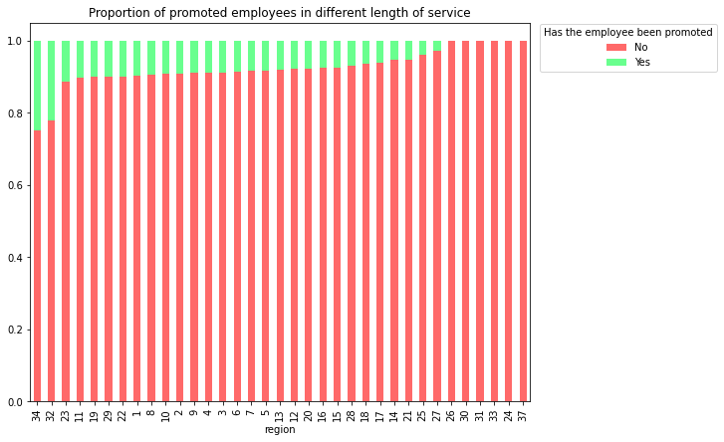
Length of Service
Only a few employees of length 32 & 34
Promotion leans more weights of length 32 & 34

Slide 28
Feature Engineering
01
03
Random Forest

Slide 29
Data Processing for ML
To begin with machine learning part, we first applied data pre-processing listed as follows.
Convert categorical columns into numerical (department, region, education, gender and recruitment channel)
Add new column - level of training for each department (low, medium, high)

Slide 30
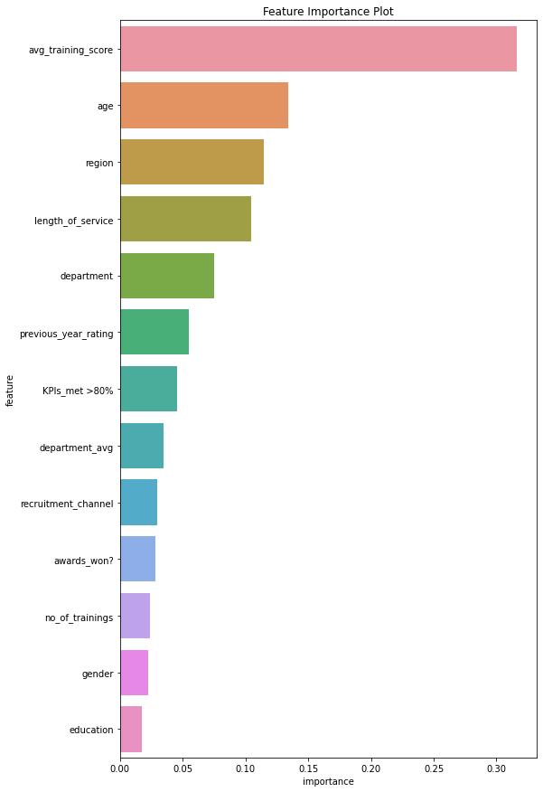
Random Forest
Top 5: avg training score, age, region, length of service, department

Slide 31
03
Models & Conclusions
04
Prediction Models
Conclusions & Recommendations

Slide 32
Model Conclusion - Random Forest
 | Precision | Recall | F1-score | support
0 | 0.94 | 1.00 | 0.97 | 13318
1 | 0.88 | 0.29 | 0.43 | 1280
Accuracy |  |  | 0.93 | 14598
Macro avg | 0.91 | 0.64 | 0.70 | 14598
Weighted avg | 0.93 | 0.93 | 0.92 | 14598

Slide 33
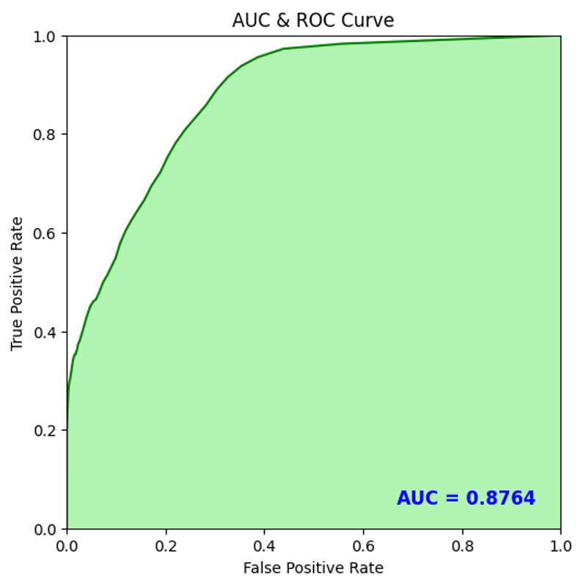
Model Conclusion - Random Forest
The area under the curve (AUC) is the measure of the ability of a classifier to distinguish between classes. The higher the AUC, the better the performance of the model.
AUC = 0.8764
Accuracy = 0.93

Slide 34
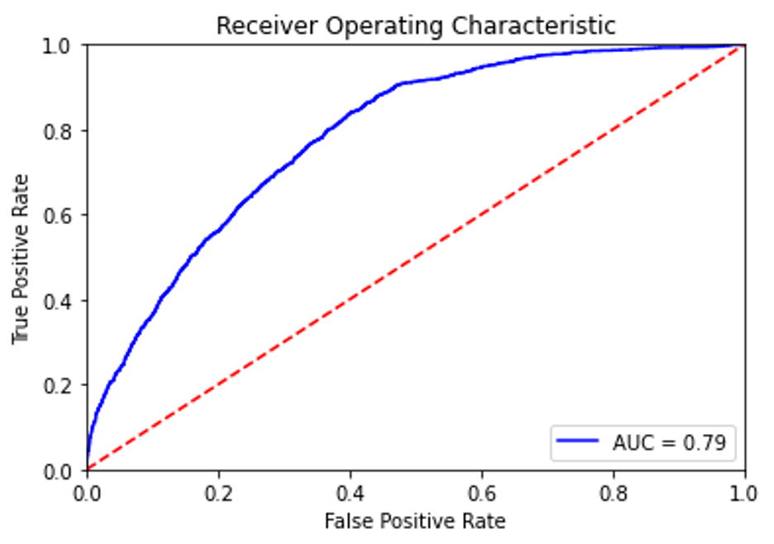
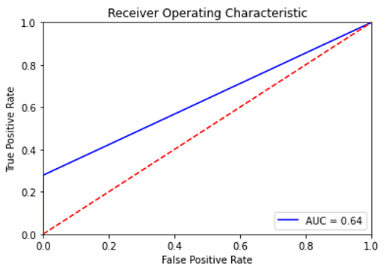
Models Continued
Gaussian Naive Bayes
XGBoost
Accuracy = 0.91 / AUC = 0.79
Accuracy = 0.94 / AUC = 0.64

Slide 35
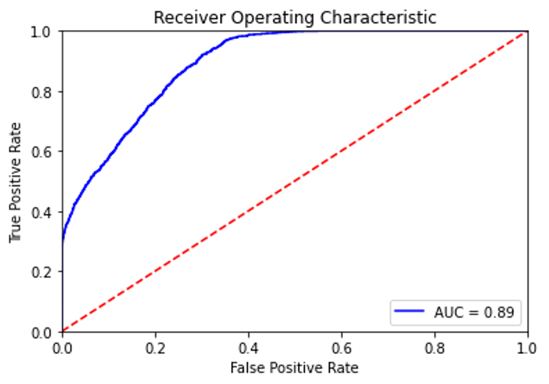
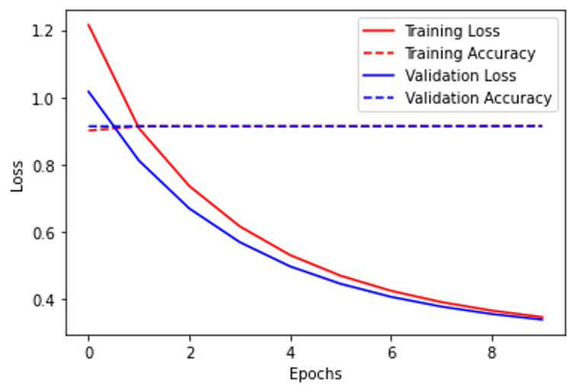
Models Continued (Deep Learning)
MLP Classifier
Neural Networks
Accuracy = 0.93 / AUC = 0.89
Accuracy = 0.91

Slide 36
‘Is_promoted’ proportion
No
01
91.3% of the employees have not been promoted
Yes
02
8.7% of the employees have been promoted

Slide 37
Prediction Models’ Summary
 | Accuracy | AUC
Gaussian Naive Bayes | 0.91 | 0.79
XGBoost | 0.90 | 0.64
Random Forest | 0.93 | 0.87
MLP | 0.93 | 0.89
Neural Networks | 0.91 | /
If we want to identify employees worthy of promotion as best as possible, we should choose random forest or the MLP classifier due to their accuracy and AUC.

Slide 38
Conclusions
This company’s promotion system is not routine and decaying, it pay less attention to personal information.
It leans to employees’ performance, which is quite encouraging due to the culture of respect for competence.
Education level, won awards, met KPI > 80%, achieved higher training score ect.
Promotion system is relatively fair.
It also emphasize the importance of technology.

Slide 39
Recommendations
Fairness
Training
Model
Possible Evaluation
Fair enough;
Not biased in gender & age
Attention to ability
Tend to promote ones with better training performance
MLP & Random Forest is good for prediction
The same engine may be useful for yearly or bi-yearly performance evaluation as well

Slide 40
Thanks!
Does anybody have any questions?
Thanks!

